Slide 1


TITLE 1 SLIDE HEADLINES
MAY BE 2 LINES
Services Risk Ranking
Q1 2026 OFS Risk Ranking: Active & Proactive Focus
Optional subtitle
Optional presenter name
Date

Slide 2

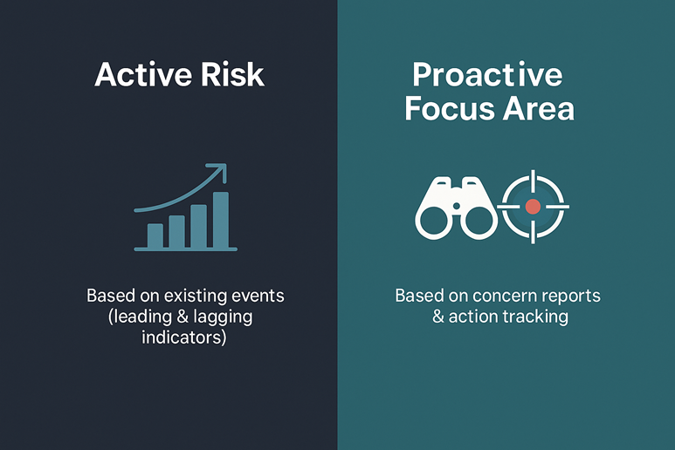
Risk Ranking Process: Data Collection
Review of Hazard Categories (Source: Gensuite )
Specific Period (Jan 2026 to Mar 2026)
Data include:
  I&I including levels A,B,C and D
  PSE and Near Misses
  Concern Reports (Negative / Positive/ Stop Work/ Escalated to ATS)
  Action Tracking System
  Near Miss
  Potentially Sever Events

Slide 3
Risk Ranking and Strategy
Strategic action Refer to the Risk management procedure TRA Tab (Q)
If the risk ranking >5 an intervention strategy required Like:
(Risk Reduction Project required and 3-month action plan developed to reduce risk level. Input to Strategic Blueprint review)
If the risk ranking is 4-5 Control strategy required like (SMART actions developed to reduce risk level)
Risk Rating & Strategy
>5 | High (Critical Step)* (Intervention Strategy)
4-5 | Medium (Control Strategy)
1-3 | Low (Supervisory Strategy)

Slide 4
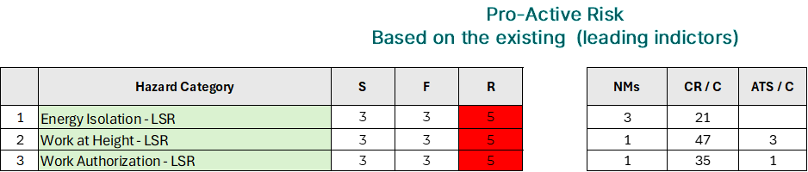
Risk Ranking Process: Global top High-Risk Activities
Active Risks (based on recordable events, including Level C/D and PSEs) and Proactive Risks (based on leading indicators such as Near Misses, Concern Reports, and ATS contributions).
The following active risks are primarily driven by Level C and Level D incidents:
Manual Handling
Live Electrical
Mechanical Lifting
Pinch Points / Sharp Objects
Line of Fire
Powered Hand Tools
The additional active risks listed below are associated with Level D incidents, supported by Near Misses (NMs), Concern Report contributions (CR/C), and ATS contributions (ATS/C):
Walking/Working Surfaces
Driving Safety
Hazardous Substances
Our recommendation is to maintain focus on these risks, alongside the proactive risks highlighted in the final table, to ensure early intervention and sustained risk reduction.

Slide 5
Global LSR Risk Profile:
Embedded Controls and Critical Focus
The majority of Life-Saving Rules (LSRs) are currently categorized as Low Risk, based on the risk ranking results. This reflects strong control measures and effective performance management across regions.
The LSR risk ranking also serves as a performance measurement tool, indicating how well each region is managing and controlling critical risks.
EU: All LSRs are low risk (green), indicating strong and consistent control across all categories
MEA: Similar trend, with Mechanical Lifting at medium risk (red) while others remain well controlled.
ASIA: All LSRs are low risk (green), indicating strong and consistent control across all categories.
LATAM: Majority of LSRs are low risk (green), with only minor variations—overall good control.
NAM: Most LSRs are low risk (green), with a few medium risks (red) indicating areas to monitor and improve.

Slide 6
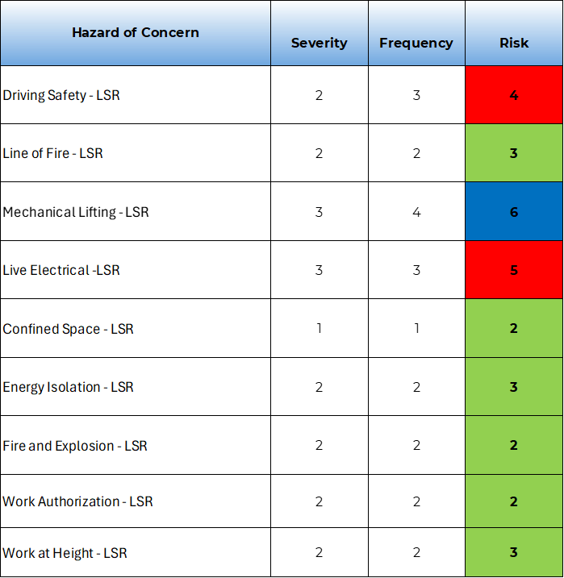
Global LSR Risk Profile:
Embedded Controls and Critical Focus
Global LSR Risk Ranking
Mechanical Lifting (LSR) is the only High Risk (blue) area, driven by higher severity and frequency → priority focus required.
Driving Safety and Live Electrical are Medium Risk (red) → monitor closely and strengthen controls.
The majority of LSRs are Low Risk (green), reflecting effective controls and good performance.
Overall Message:
The current profile shows strong control across most LSRs, with targeted attention needed on Mechanical Lifting, Driving Safety, and Live Electrical to further reduce risk exposure.

Slide 7
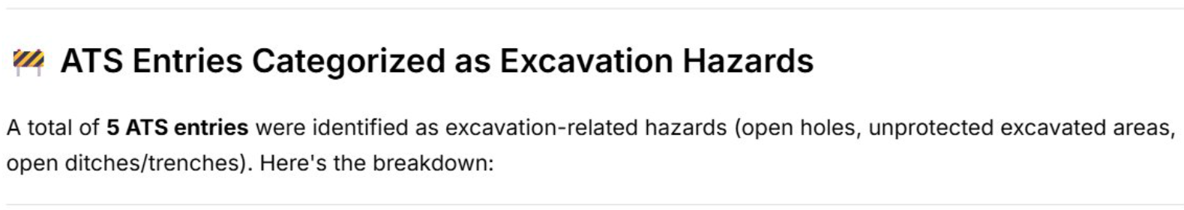
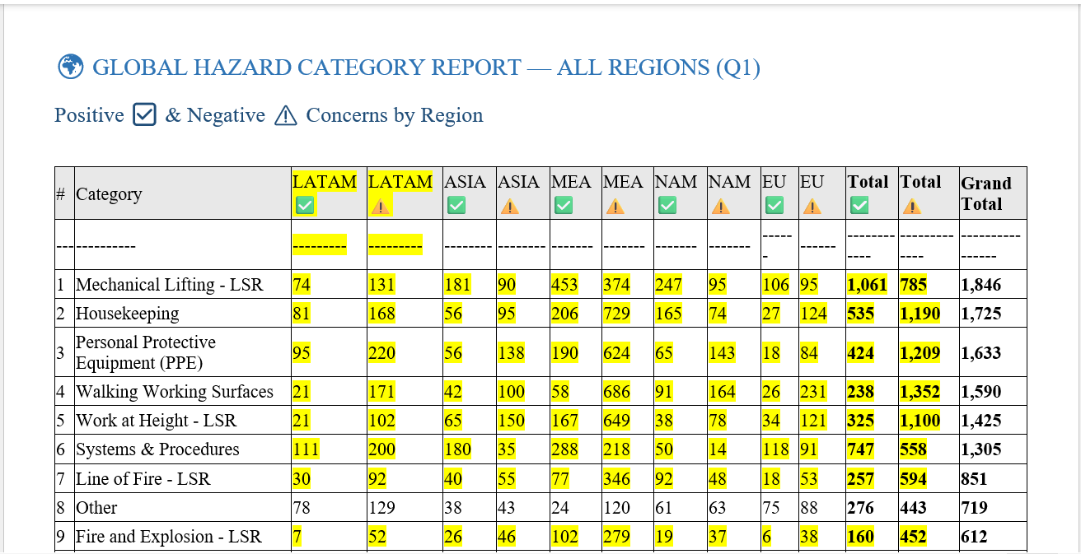
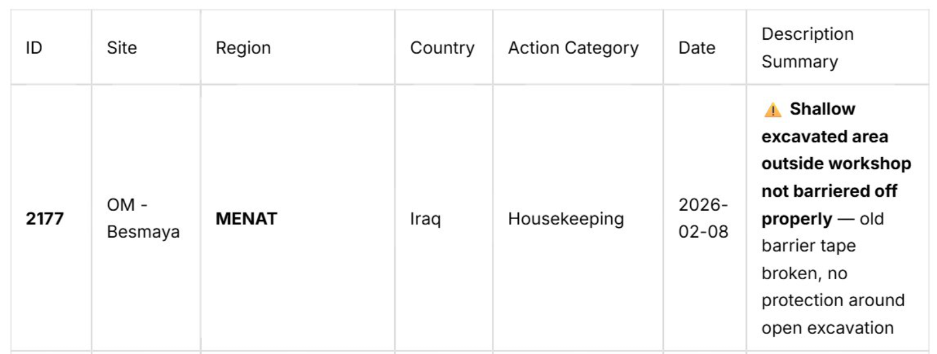
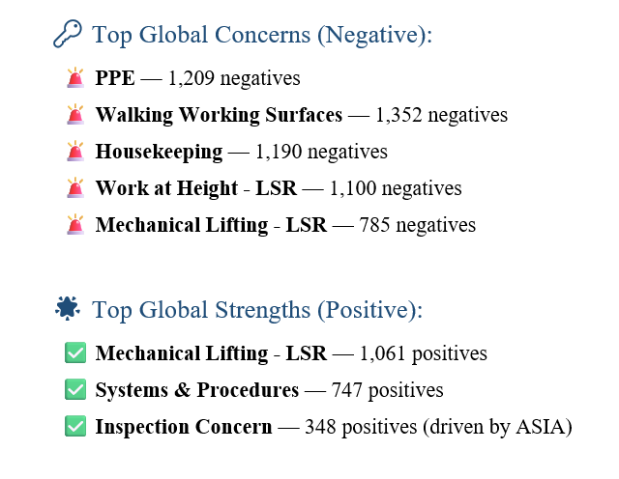
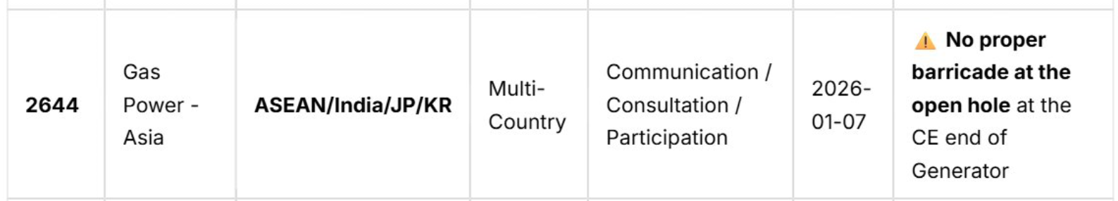
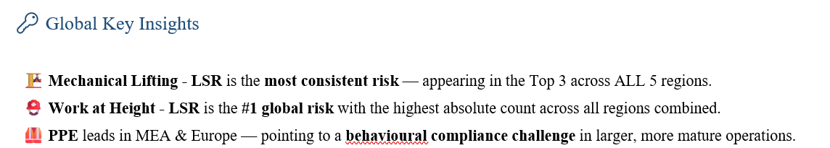
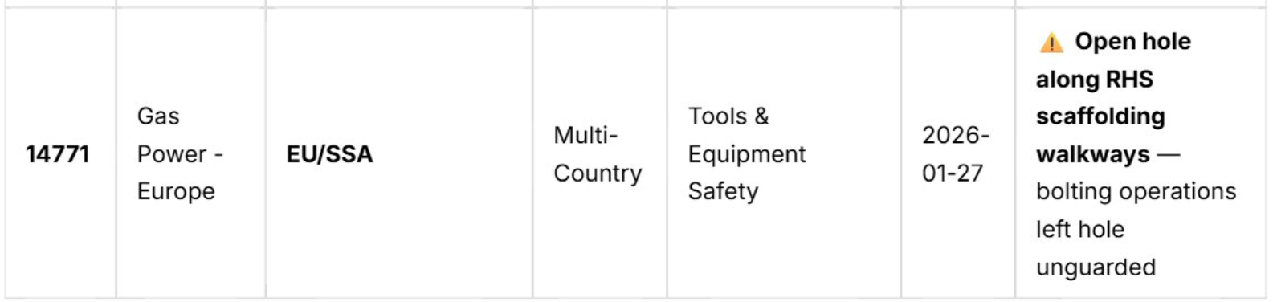
AI Analysis: Strengths and Areas for Improvement

Slide 8
BACK UP Slides

Slide 9
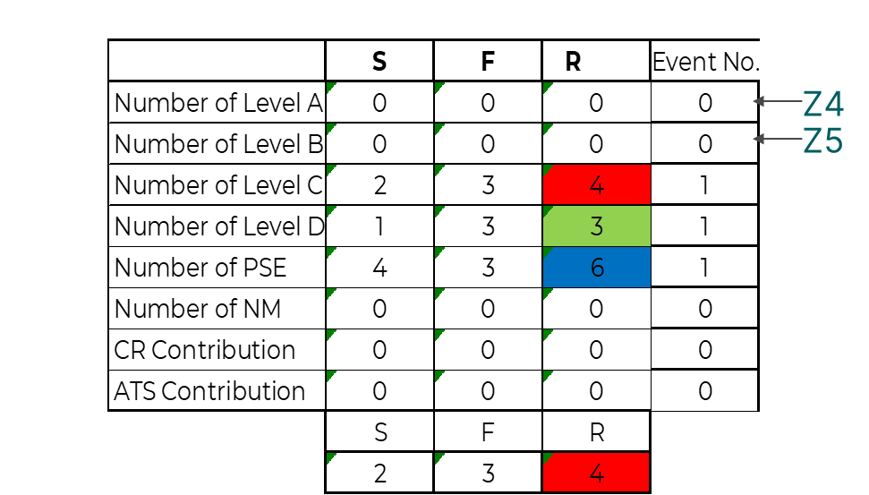
Explanation for Level A
S (Severity) Value for the Contributions for Levels A and B
Calculating the severity for Level A (Z4) & Level B (Z5)
Explanation for Level B
Formula:
This formula determines a specific value based on the value in cell Z4 (Numbers of Level A).
Logic:
If Z4 is 0, the result is 0.
If Z4 is one or greater, the result is 5.
Formula:
This formula determines a specific value based on the value in cell Z5 (Numbers of Level B).
Logic:
If Z5 is 0, the result is 0.
If Z5 is one or greater, the result is 4.

Slide 10

S (Severity) Value for the Contributions for Levels C , and D
Calculating the severity for Level C (Z6) & Level D ( Z7)
Explanation for Level C
Explanation for Level D
Formula:
This formula determines a specific value based on the value in cell Z6 (Numbers of Level C).
Logic:
If Z6 is 0, the result is 0.
If Z6 is 1 or 2, the result is 2.
If Z6 is 3 or Greater, the result is 3
Formula:
This formula determines a specific value based on the value in cell Z7 (Numbers of Level D).
Logic:
If Z7 is 0, the result is 0.
If Z7 is 1 or 2, or 3 the result is 1.
If Z7 is Greater than 3, the result is 2

Slide 11

Explanation for PSE
S (Severity) Value for the Contributions for PSE and NM
Calculating the severity for PSE (Z8) & NM (Z9)
Explanation for NM
Formula:
This formula determines a specific value based on the value in cell Z8 (Numbers of PSEs).
Logic:
If Z8 is 0, the result is 0.
If Z8 is one or greater, the result is 4.
Formula:
This formula determines a specific value based on the value in cell Z9 (Numbers of NMs).
Logic:
If Z9 is 0, the result is 0.
If Z9 is 1, 2, or 3 the result is 1.
If Z9 is greater than 3, the result is 2.

Slide 12
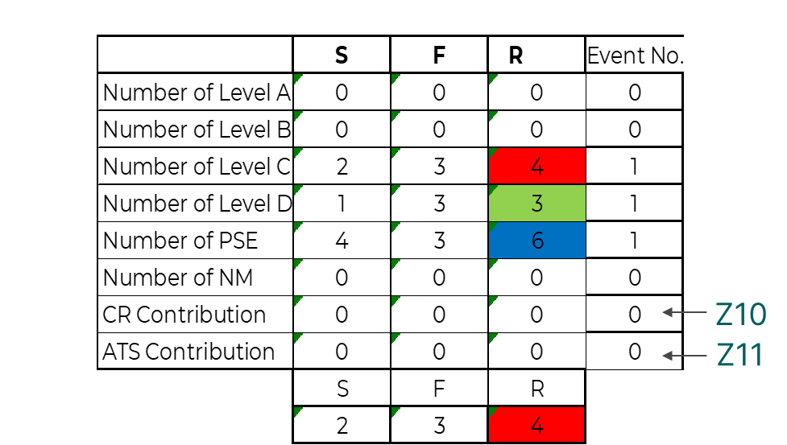
Explanation for CR & ATS
S (Severity) Value for the Contributions CR and ATS
Calculating the severity for CR (Z10) & ATS (Z11)
Formula:
This formula determines a specific value based on the value in cell Z10 (ATS contribution) or Z11 (CR Contribution)
Logic:
If Z10 or Z11 is 0, the result is 0.
If Z10 or Z11 is 1 or 2, the result is 1.
If Z10 or Z11 is 3 to 9, the result is 2
If Z10 or Z11 is 10 to 19, the result is 3
If Z10 or Z11 is 20 or greater, the result is 4

Slide 13

Explanation for Level A, B, C, D or PSE
F (Frequency) Value for the Contributions Levels A, B, C , D, PSE
Calculating the Frequency for the levels A (Z4), B (Z5), C (Z6), D (Z7) and PSE (Z8)
Formula:
This formula assigned a value to F based on the value in cell Z4,5,6,7 or Z8 (Numbers of Level A,B,C,D or PSE).
Logic:
If Z4,5,6,7 or Z8 is 0, the result is 0.
If Z4,5,6,7 or Z8 is 1,2, or 3 the result is 3
If Z4,5,6,7 or Z8 is 4 to 11, the result is 4
If Z4,5,6,7 or Z8 is 12 or greater, the result is 5.

Slide 14

F (Frequency) Value for the Contributions of NMs
Calculating the Frequency for the NMs (Z9)
Explanation for NMs
Formula:
This formula assigned a value to F based on a value of Z9 (Numbers of NMs).
Logic:
If Z9 is 0, the result is 0.
If Z9 is 1,2, or 3 the result is 2
If Z9 is 4 to 8, the result is 3
If Z9 is 9 to11, the result is 4
If Z9 is 12 or greater, the result is 5.

Slide 15
F (Frequency) Value for the CR and ATS Contributions
Calculating the Frequency for the CR (Z10) & ATS (Z11)
Explanation for CR & ATS
Formula:
This formula assigned a value to F based on the value in cell Z10 or Z11 (CR & ATS Contribution).
Logic:
If Z10 or Z11 is 0, the result is 0.
If Z10 or Z11 is 1 to 6, the result is 1
If Z10 or Z11 is 7 to 9, the result is 2
If Z10 or Z11 is 10 to 19, the result is 3.
If Z10 or Z11 is 20 or greater, the result is 4.

Slide 16
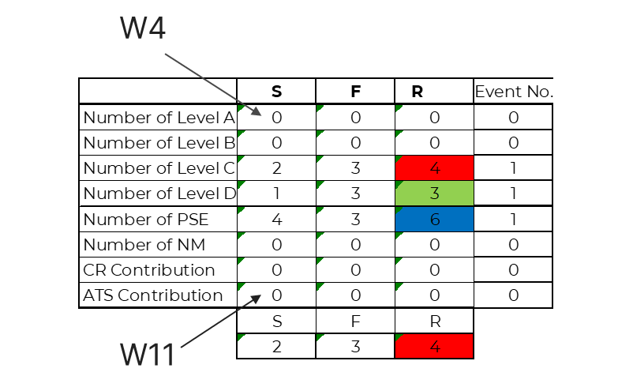
Overall Severity (S) Calculation
Formula: =AVERAGE(LARGE(W4:W11, {1,2,3}))
Explanation:
This formula calculates the average of the three largest values in the range W4:W11, representing the severity scores.
Steps:
Identify the three highest values within the range W4:W11.
Calculate the average of these three values.
Example Calculation:
Severity Scores: {0, 0, 2, 1, 4, 0, 0, 0}
Top 3 Severity Scores: {2, 1, 4}
Average Severity (S): (2+1+4)/3=2.33=2
​

Slide 17
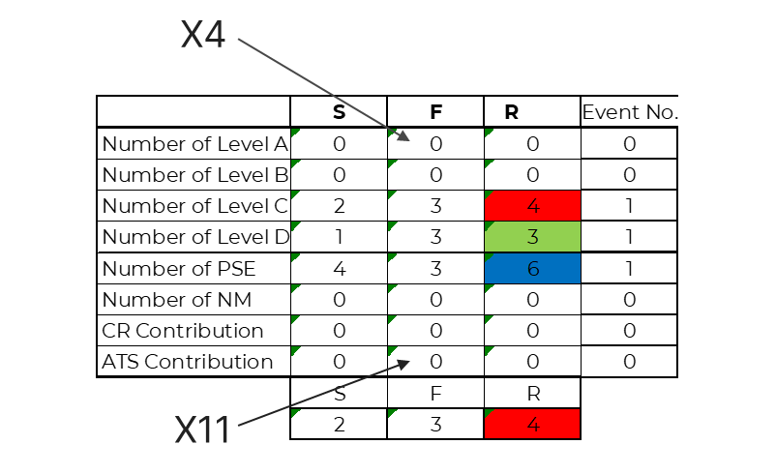
Overall Frequency (F) Calculation
Formula: =AVERAGE(LARGE(X4:X11, {1,2,3}))
Explanation:
This formula calculates the average of the three largest values in the range X4:X11, representing the severity scores.
Steps:
Identify the three highest values within the range X4:X11.
Calculate the average of these three values.
Example Calculation:
Frequency Scores: {0, 0, 3, 3, 3, 0, 0, 0}
Top 3 Frequency Scores: {3, 3, 3}
Average Frequency (F): (3+3+3)3=3
​

Slide 18
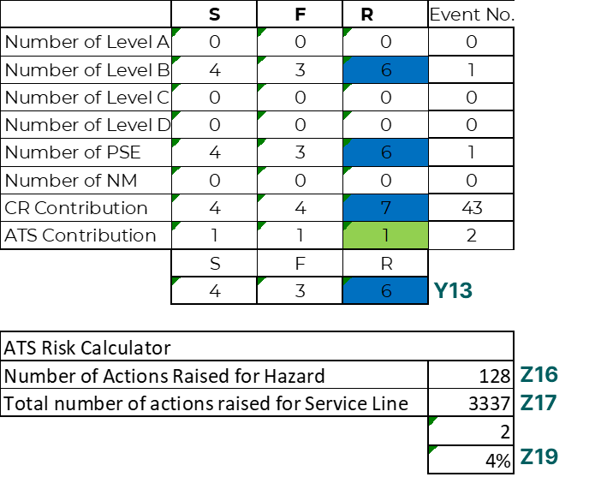
ATS Risk Contribution Formula
=IF((AND(Y13>4,Z19<0.021)),Z16/Z17*600,Z16/Z17*50)
Y13 (is the Risk Level) R
Z16 (The number of actions for the hazard)
Z17 (The total number of all the ATS)
Z19 (The percentage of the actions (Z16/Z17)
How it Work
The conditions check:
Y13 > 4and Z19 < 0.021
Calculation
•If True: (Z16 / Z17) * 600
•If False: (Z16 / Z17) * 50
Rationale Behind Multipliers:
600 (True Condition):
  High-risk, low-hazard actions
  Urgent intervention
50 (False Condition):
  Lower risk or adequate actions
  Balanced response
Summary:
The process ranks resource allocation by assessing the level of risk and the adequacy of our response to potential hazards (ATS). High-risk situations with low-hazard actions (ATS) necessitate urgent intervention, while lower-risk or adequately addressed actions receive a balanced contribution.
References is ISO 31000:2018 Risk Management – Guidelines & IEC 31010:2019 Risk Management – Risk Assessment Techniques for more info links below

Slide 19
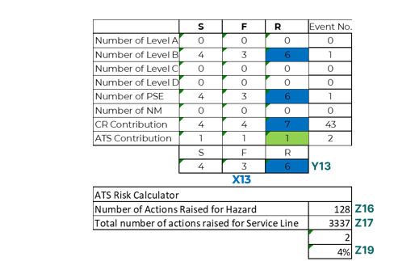
ATS Contribution Changes – Before Vs After
=IF((AND(Y13>4,Z19<0.021)),Z16/Z17*600,Z16/Z17*50)
Aspect | Before (Old Method) | After (Enhanced Method – Standards-Aligned)
Trigger Condition Variable | X13 (Total Average Frequency only) | Y13 (Total Risk Score = Severity + Frequency)
Trigger Logic | IF(AND(X13 > 4, Z19 < 0.021)) | IF(AND(Y13 > 4, Z19 < 0.021))
Trigger Justification | Focused only on likelihood (frequency) | Aligned with ISO 31000 Clause 6.4.3 and IEC 31010 – considers consequence + likelihood
Compliance Level | Partial compliance – only one risk dimension | Full compliance – holistic risk evaluation approach
Decision-Making Value | May overemphasize frequent low-impact risks | Accurately identifies high-risk, low-response hazards
Strategic Value | Operational metric | Strategic, standards-aligned performance index
Summary:
The new method, which uses the Total Risk Score (Y13) rather than just the Frequency (X13), is more accurate and robust because it evaluates risk in a more holistic manner. By considering both the severity and frequency of events, the formula reflects the true risk level rather than being skewed by frequent low-severity occurrences. This ensures that ATS contribution weighting is applied only when there is a genuine mismatch between high risk and low corrective action ratios, enabling better prioritization of actions and resource allocation. This approach also enhances decision-making effectiveness in line with ISO 31000’s emphasis on risk-informed decisions and IEC 31010’s recommendation to use compound risk scoring methods for ranking and prioritizing risks.
References is ISO 31000:2018 Risk Management – Guidelines & IEC 31010:2019 Risk Management – Risk Assessment Techniques for more info links below

Slide 20
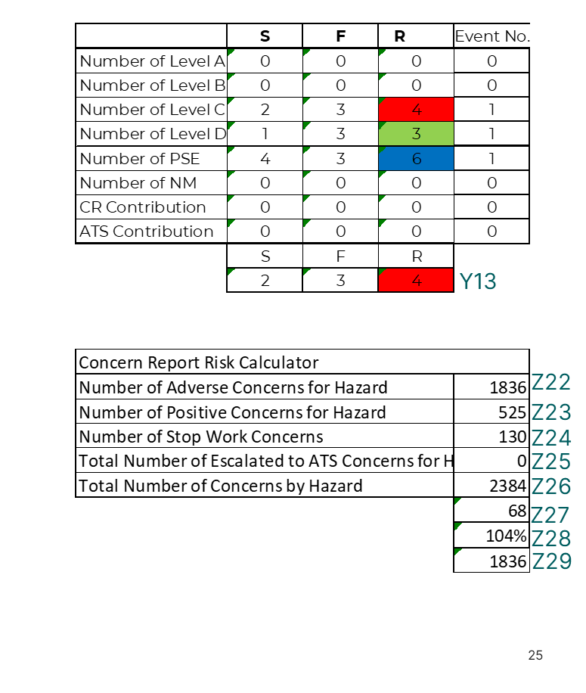
Concern Reports Contributions Calculations
Adverse Concern Multiplier
Weighted Concern Index
Primary Calculation:
=IF((AND(Y13>=3,Z28<0.031)),Z22*36,Z22)
Y13 (Risk): The risk level.
Z28: Percentage of(adverse, positive, and stop work concerns relative to the total number of CRs) (Z22+Z23+Z24)/Z26
Z22: Number of adverse concerns.
Purpose: To adjust the count of adverse concerns based on the risk level and the relative percentage of all concerns related to the hazard.
Logic:
If the risk level (Y13) is 3 or higher and the percentage of specific concerns (Z28) is less than 3.1%, then multiply the number of adverse concerns (Z22) by 36.
Otherwise, use the number of adverse concerns (Z22) as is.
Secondary Calculation:
((Z29-(Z22*0.5)-(Z23*0.1)+(Z24*3)+(Z25*15))/(Z26))*130
Z29: Result from the primary calculation.
Z22: Number of adverse concerns.
Z23: Number of positive concerns.
Z24: Number of stop works.
Z25: Number of escalated concerns.
Z26: Total number of concerns.
Purpose: To develop the final concern report contributions.(Z27)
Components:
Adjust Z29 (from primary calculation) by subtracting a fraction of adverse and positive concerns and adding weighted values of stop work and escalated concerns.
Normalize by the total number of concerns (Z26) and scale the result.
References is ISO 31000:2018 Risk Management – Guidelines & IEC 31010:2019 Risk Management – Risk Assessment Techniques for more info links below

Slide 21
Concern Reports Contributions Calculations
Rationale Behind the Multipliers in the First Calculations :
=IF((AND(Y13>=3,Z28<0.031)),Z22*36,Z22)
Weighting Factors in Secondary Calculation:
((Z29-(Z22*0.5)-(Z23*0.1)+(Z24*3)+(Z25*15))/(Z26))*130
36 for High Risk and Low Response:
The high multiplier (36)* emphasizes the urgency and significant impact of addressing adverse concerns when the risk is high, and the percentage of these concerns is relatively low. This multiplier effectively amplifies the weight of these concerns, making it clear that urgent attention and resources are needed to address the identified hazards adequately.
Concept of Scaling:
Scaling factors like 36 in risk management ensures that critical issues receive proportionate focus and resources. By amplifying the adverse concerns in high-risk scenarios, the organization can prioritize the most needed interventions.
*Values such as 0.5 and 0.1 and the multipliers are determined based on historical analysis and standard practices to ensure accuracy and effectiveness in risk assessment.
0.5* for Adverse Concerns (Z22): This number reflects the significant impact of adverse concerns but also accounts for other concerns in the overall calculation.
0.1* for Positive Concerns (Z23): While positive concerns have a smaller negative impact on the risk score, they are acknowledged for their contribution at a lower weight, ensuring a fair and balanced consideration of all concerns.
3 for Stop Work (Z24): Stop work orders are critical safety interventions, so they are assigned a higher positive weight to reflect their importance in mitigating risk.
15 for Escalated Concerns (Z25): Escalated concerns are highly significant as they indicate severe issues that require immediate and substantial intervention, thus giving the highest weight.
Scaling Factor 130: Normalizes the final score to ensure it is within a manageable and interpretable range for decision-making.
References is ISO 31000:2018 Risk Management – Guidelines & IEC 31010:2019 Risk Management – Risk Assessment Techniques for more info links below

Slide 22
Concern Reports Contributions Calculations
CRs contribution Calculation Process
Input Values:
Risk (Y13)
Adverse Concerns (Z22)
Positive Concerns (Z23)
Stop Work (Z24)
Escalated Concerns (Z25)
Total Concerns (Z26)
Primary Calculation:
Adjust Z22 based on risk and concern percentage.
Secondary Calculation:
Combine adjusted Z22 with other concern metrics.
Normalize and scale to get the final contribution.
Summary:
This two-step calculation helps prioritize and quantify the contributions of different types of concerns, emphasizing higher risk and specific types of concerns (stop works, escalated concerns).
Provides a structured and quantifiable approach to understand and manage risks based on detailed concern metrics.
References is ISO 31000:2018 Risk Management – Guidelines & IEC 31010:2019 Risk Management – Risk Assessment Techniques for more info links below

Slide 23
Concern Reports Average Calculation – Before Vs After
Aspect | Before (Old Method – Service Line Level) | After (Enhanced Method – Hazard Level)
Calculation Formula | Concern Average = (Adverse + Positive + Stop Work) / Total Concerns Raised by Service Line | Concern Average = (Adverse + Positive + Stop Work) / Total Concerns by Hazard
Data Entry Level | Service Line Total | Hazard Specific
Detail and Specificity | Low – Aggregated reporting across all hazards | High – Granular insights at hazard level
Cross-Hazard Comparability | Easier – Single benchmark across service lines | Moderate – Detailed but varies per hazard
Standards Alignment | Acceptable, but general | More substantial alignment with ISO 31000 Clause 6.3 and IEC 31010 indexing techniques
Strategic Value | General organizational KPI | Supports specific hazard-focused risk control and cultural improvement
Summary:
The transition from service line–level concern averaging to hazard-level averaging significantly improves the specificity and accuracy of behavioral safety metrics. By applying ISO 31000 Clause 6.3, the enhanced approach better reflects the specific risk context of each hazard rather than masking variations under broader service line totals. This also aligns with IEC 31010’s recommendation to utilize scoring/indexing methods to improve traceability, detect under-reporting, and refine decision-making. Consequently, this method enables a more proactive and effective risk management process by tying concern reporting trends directly to the specific hazard landscape.
References is ISO 31000:2018 Risk Management – Guidelines & IEC 31010:2019 Risk Management – Risk Assessment Techniques for more info links below

Slide 24
Concern Reports Average Enhancement – Including Escalated ATS Concerns
New 2025
Before =(K26+K27+K28)/K30
Aspect | Previous Hazard-Level Calculation | Enhanced Hazard-Level Calculation (Including ATS Escalations)
Calculation Formula | Concern Average = (Adverse + Positive + Stop Work) / Total Concerns by Hazard | Concern Average = (Adverse + Positive + Stop Work + Escalated to ATS) / Total Concerns by Hazard
Scope of Indicator | Measures general safety engagement | Expanded to include escalation behavior reflecting proactive risk reporting
Behavioral Insight | Focus on initial reporting behavior | Captures both reporting and follow-through into ATS escalation
Standards Alignment | Aligned with ISO 31000 Clause 6.4.3 (risk behavior indicators) | More extensive alignment with IEC 31010 – integration of leading indicators and proactive risk culture metrics
Strategic Value | Hazard-level culture monitoring | Enhanced tracking of risk responsiveness and escalation maturity
Proposed =(K26+K27+K28+K29)/K30
Concern Report Risk Calculator
Number of Adverse Concerns for Hazard | 647 | K26
Number of Positive Concerns for Hazard | 178 | K27
Number of Stop Work Concerns | 79 | K28
Total Number of Escalated to ATS Concerns for Hazard | 2 | K29
Total Number of Concerns by Hazard | 825 | K30
CR Contribution | 90
Avarage CR By Hazard | 110%
Adjusted Value | 647
Summary:
The inclusion of escalated ATS concerns in the Concern Report Average formula is methodologically justified and strategically important. While it is also utilized in ATS Contribution calculations, it represents different behavioral and performance dimensions in each context. This dual-role application aligns with ISO 31000:2018 and IEC 31010:2019 principles of integrated risk evaluation and ensures a more holistic view of safety culture maturity and escalation responsiveness, without redundancy or analytical overlap.
References is ISO 31000:2018 Risk Management – Guidelines & IEC 31010:2019 Risk Management – Risk Assessment Techniques for more info links below

Slide 25
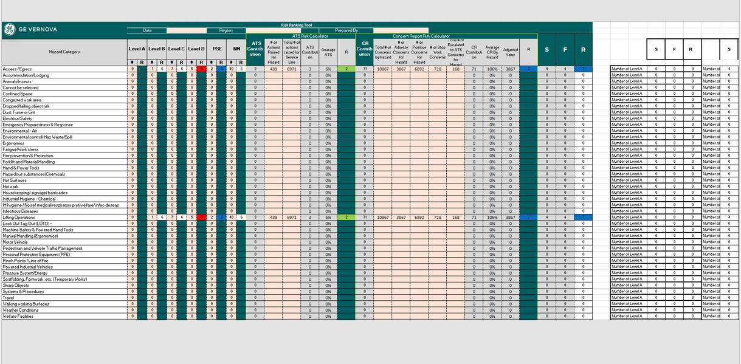
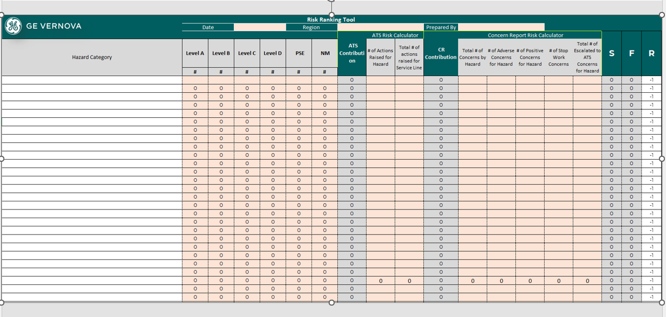
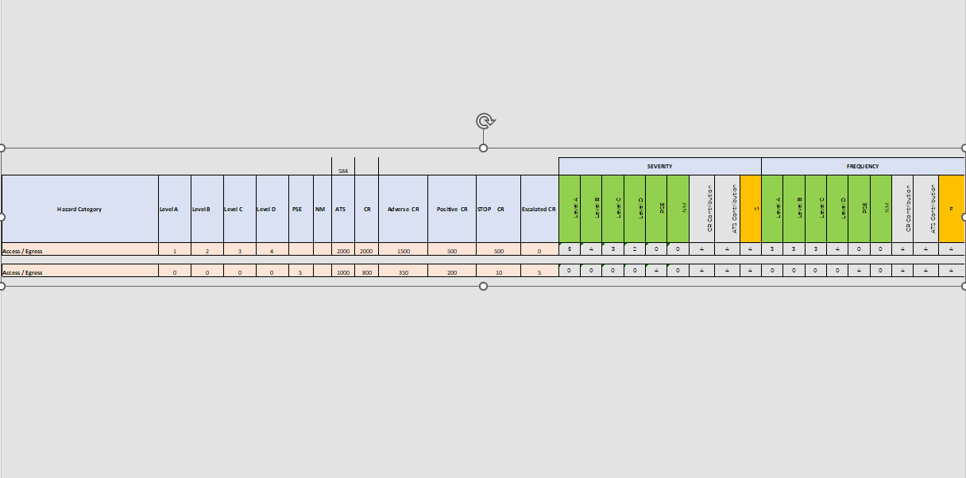
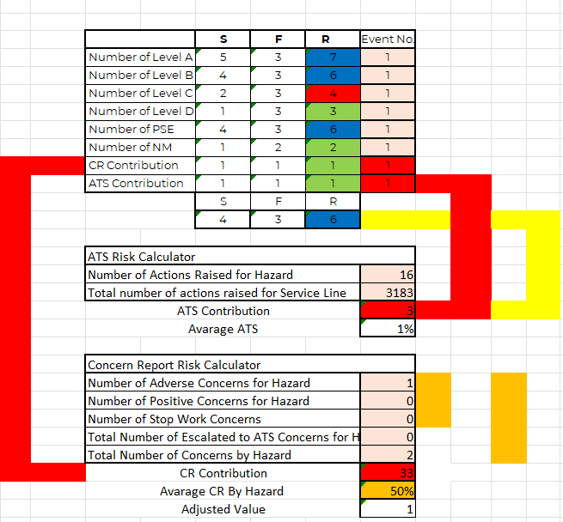
Area of improvement 2025

